Slide 1
TSKS14 Multiple Antenna Communications
Lecture 12, 2020
Emil Björnson

Slide 2
Outline of this lecture
Evolution of cellular networks
Three ways to make improvements
The role of multiple antennas
Summary of main benefits of multiple antenna communications
Outlook towards the future

Slide 3
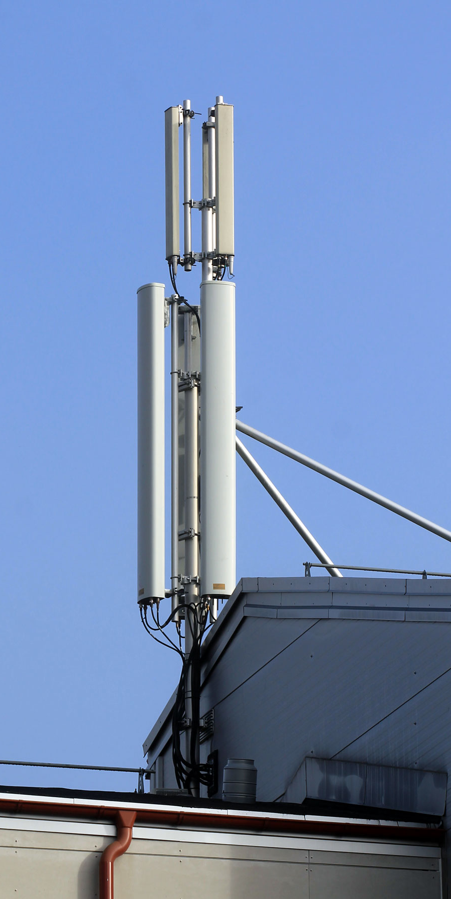
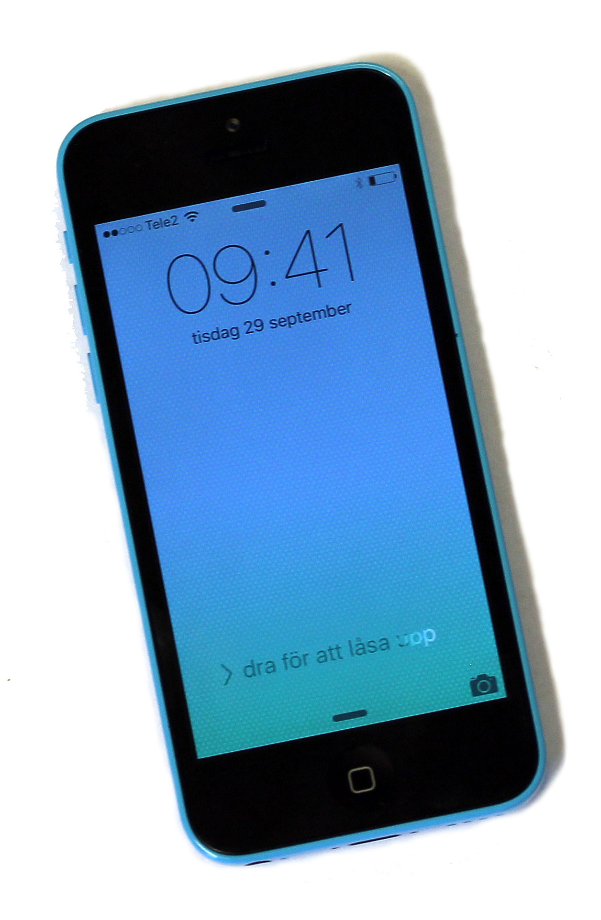
Martin Cooper’s law
The number of data connections has doubled every 2.5 years
Since beginning of wireless
Annual growth: +32%

Slide 4
Cellular networks
Proposed in 1950s
First deployed in late 1970s

Slide 5
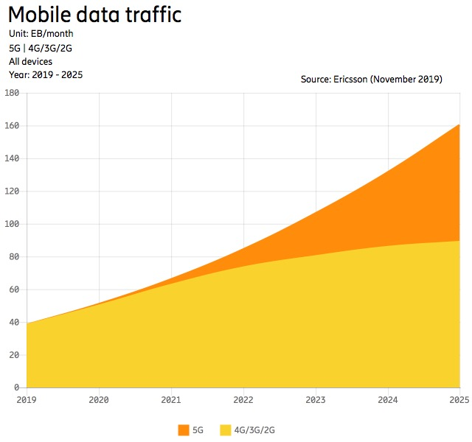
Current trends
26% annual growth (slower than in the past)
20 GB/month/person
5 GB/month/person

Slide 6
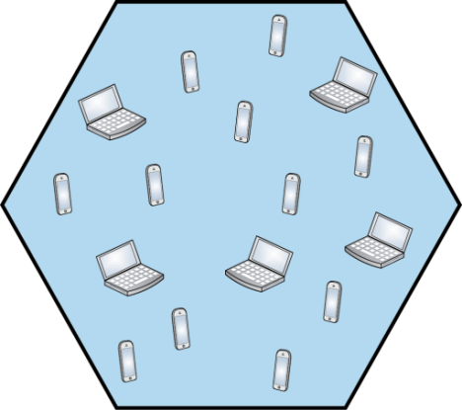
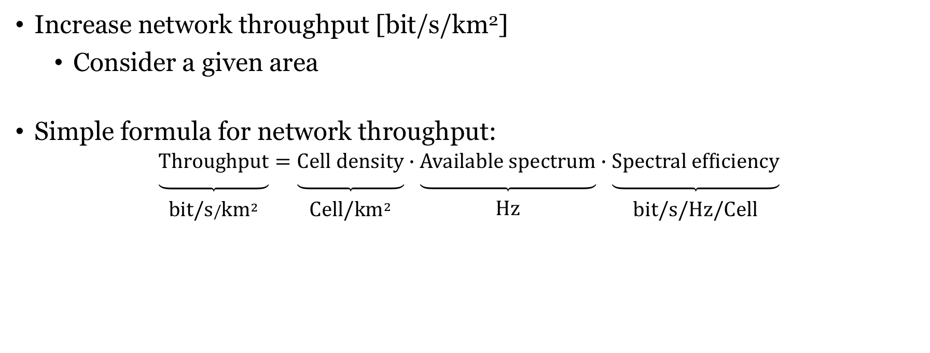
Evolving cellular networks for higher traffic
Increase network throughput [bit/s/km²]
Consider a given area
Simple formula for network throughput:
$$\underset{\begin{matrix} \\ \text{bit}\text{/}\text{s}/{\text{km}}^{2}\end{matrix}}{\underbrace{\text{Throughput}}}=\underset{\begin{matrix} \\ \text{Cell}\text{/}{\text{km}}^{2}\end{matrix}}{\underbrace{\text{Cell} \text{density}}}∙\underset{\begin{matrix} \\ \text{Hz}\end{matrix}}{\underbrace{\text{Available} \text{spectrum}}}∙\underset{\begin{matrix} \\ \text{bit}\text{/}\text{s}\text{/}\text{Hz}\text{/}\text{Cell}\end{matrix}}{\underbrace{\text{Spectral} \text{efficiency}}}$$
How to achieve a 100x improvement?

Slide 7
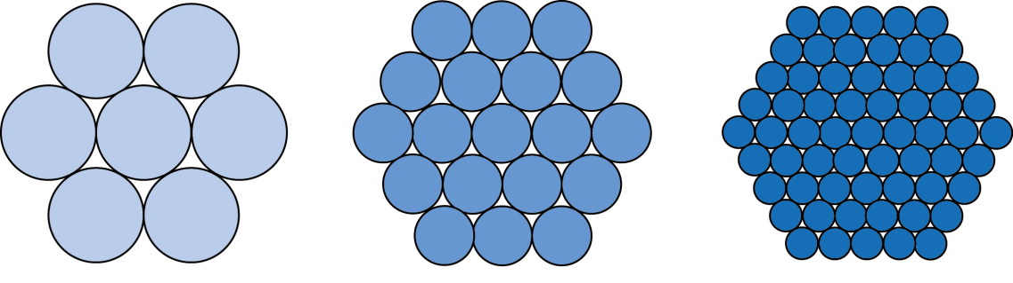
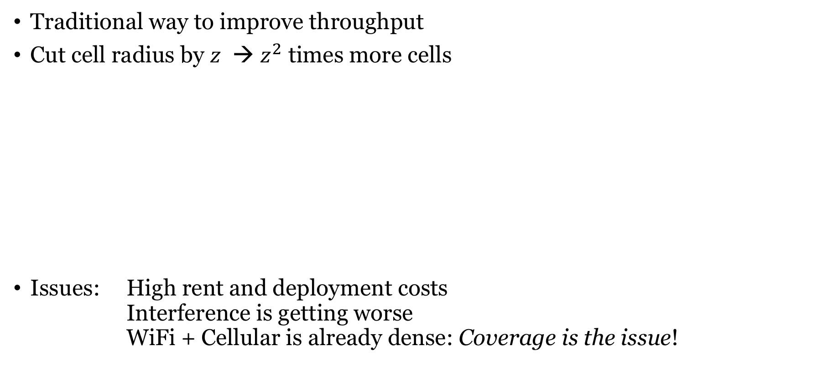
Higher cell density
Traditional way to improve throughput
Cut cell radius by $z$ → $z^{2}$ times more cells
Issues: High rent and deployment costs Interference is getting worse WiFi + Cellular is already dense: Coverage is the issue!

Slide 8
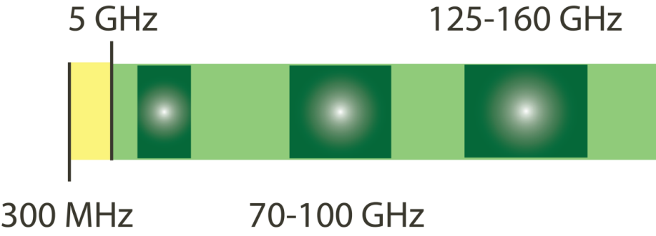

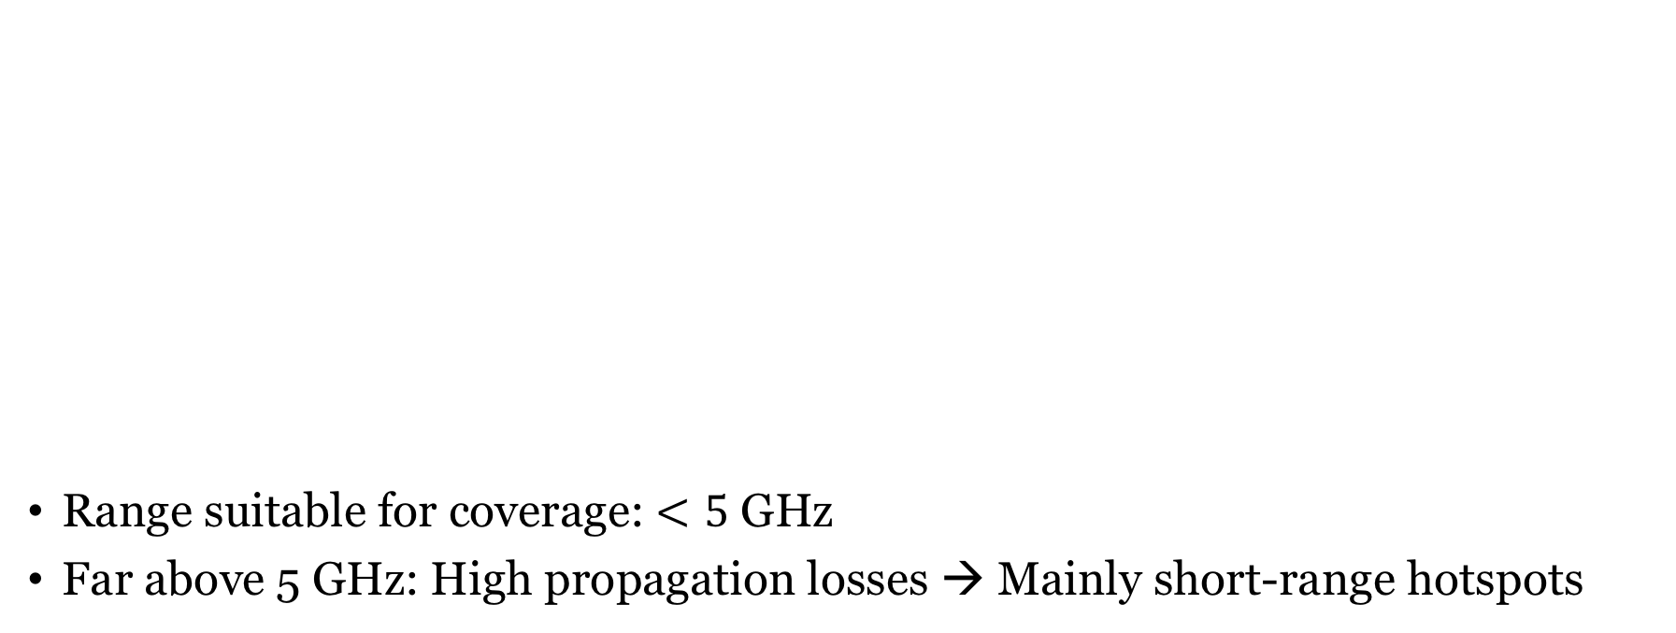
More spectrum
mmWave spectrum
400-800 THz
Range suitable for coverage: $<5$ GHz
Far above 5 GHz: High propagation losses → Mainly short-range hotspots
FM radio
…
2G/3G/4G/WiFi
Visible light
Range considered in 5G
MIMO plays different roles in different bands

Slide 9
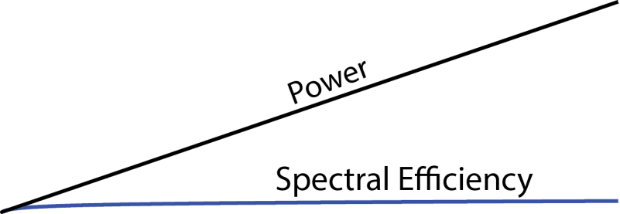
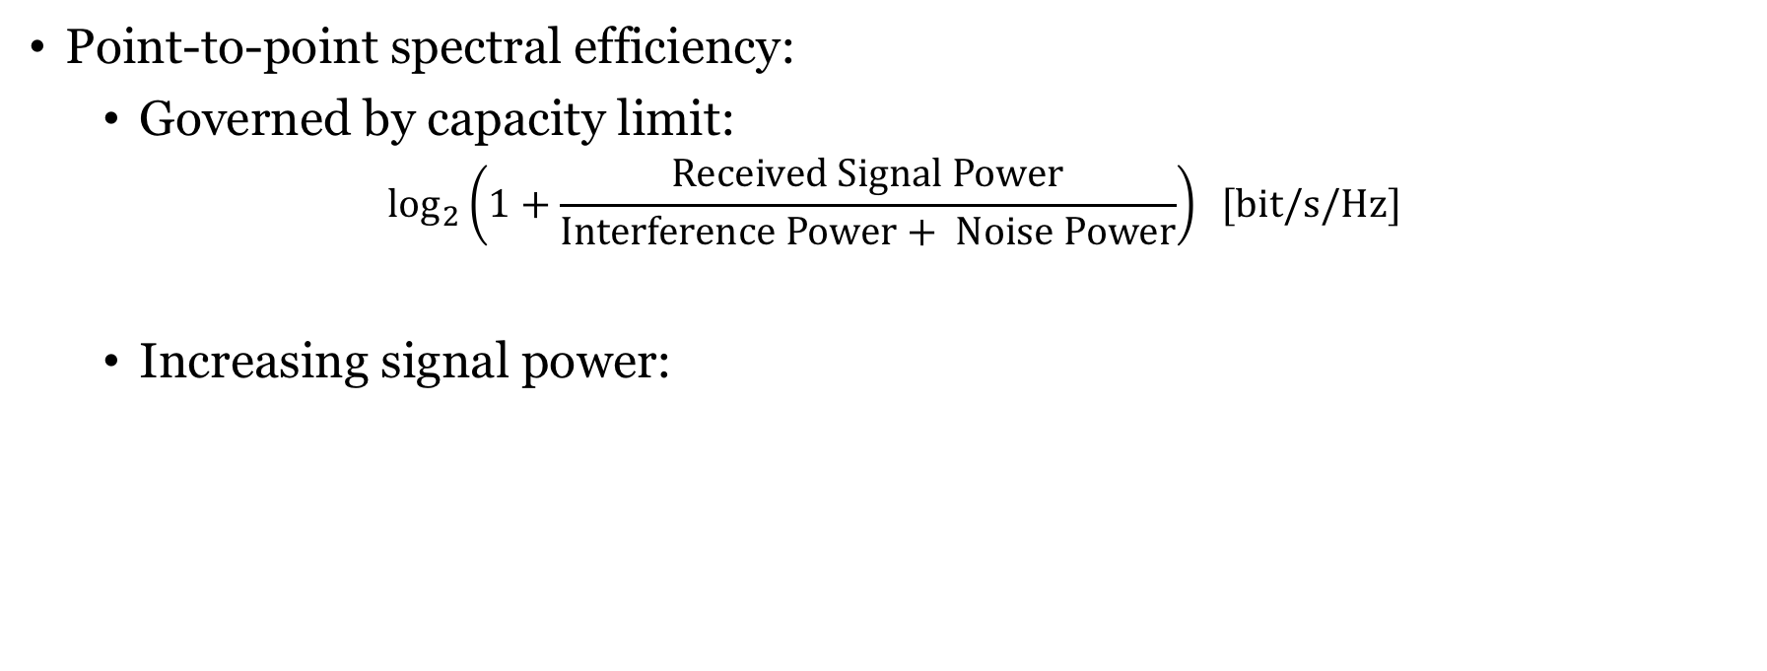
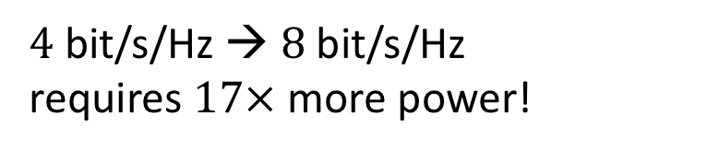
Higher spectral efficiency
Point-to-point spectral efficiency:
Governed by capacity limit:
$$\log_{2}\left(1+\frac{\text{Received} \text{Signal} \text{Power}}{\text{Interference} \text{Power}+ \text{Noise} \text{Power}}\right) [\text{bit}\text{/}\text{s}\text{/}\text{Hz}\text{]}$$
Increasing signal power:
$4$ bit/s/Hz → $8$ bit/s/Hz requires $17×$ more power!
Use multiple antennas instead!

Slide 10
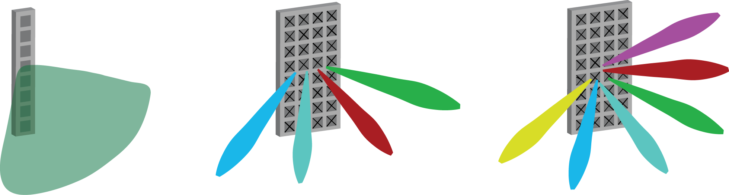

Fixed beamforming
Fixed beam
with 16 dBi gain
Unlucky users
No benefit from antenna gain
Lucky users
16 dB = 40 times stronger signal
We need adaptive beamforming!

Slide 11
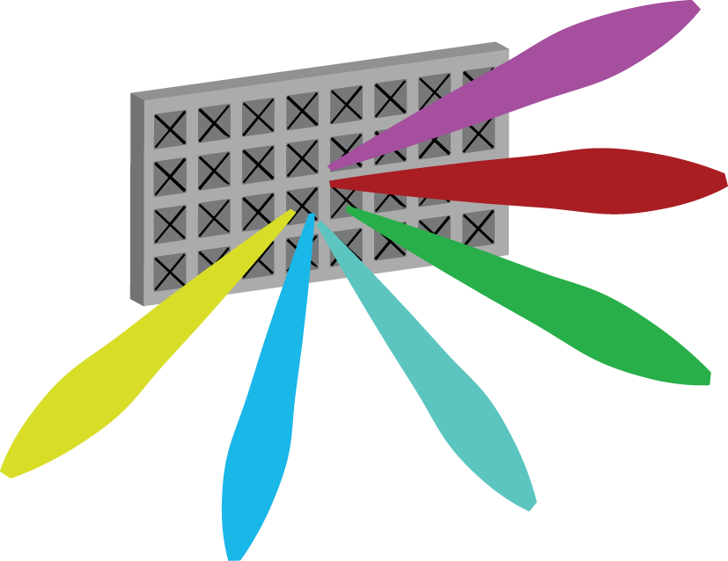
Evolution of “active” antenna technology
1 antenna
64 antennas
8 antennas
Sector antenna
8 elements (7 dBi each)
1 transceiver chain
Fixed beam 16 dBi
Classical antenna array
64 elements (32 per polarization)
8 transceiver chains (2 per column)
Up to 8 horizontal beams
Massive antenna array
64 elements
64 transceiver chains
Up to 64 3D beams

Slide 12
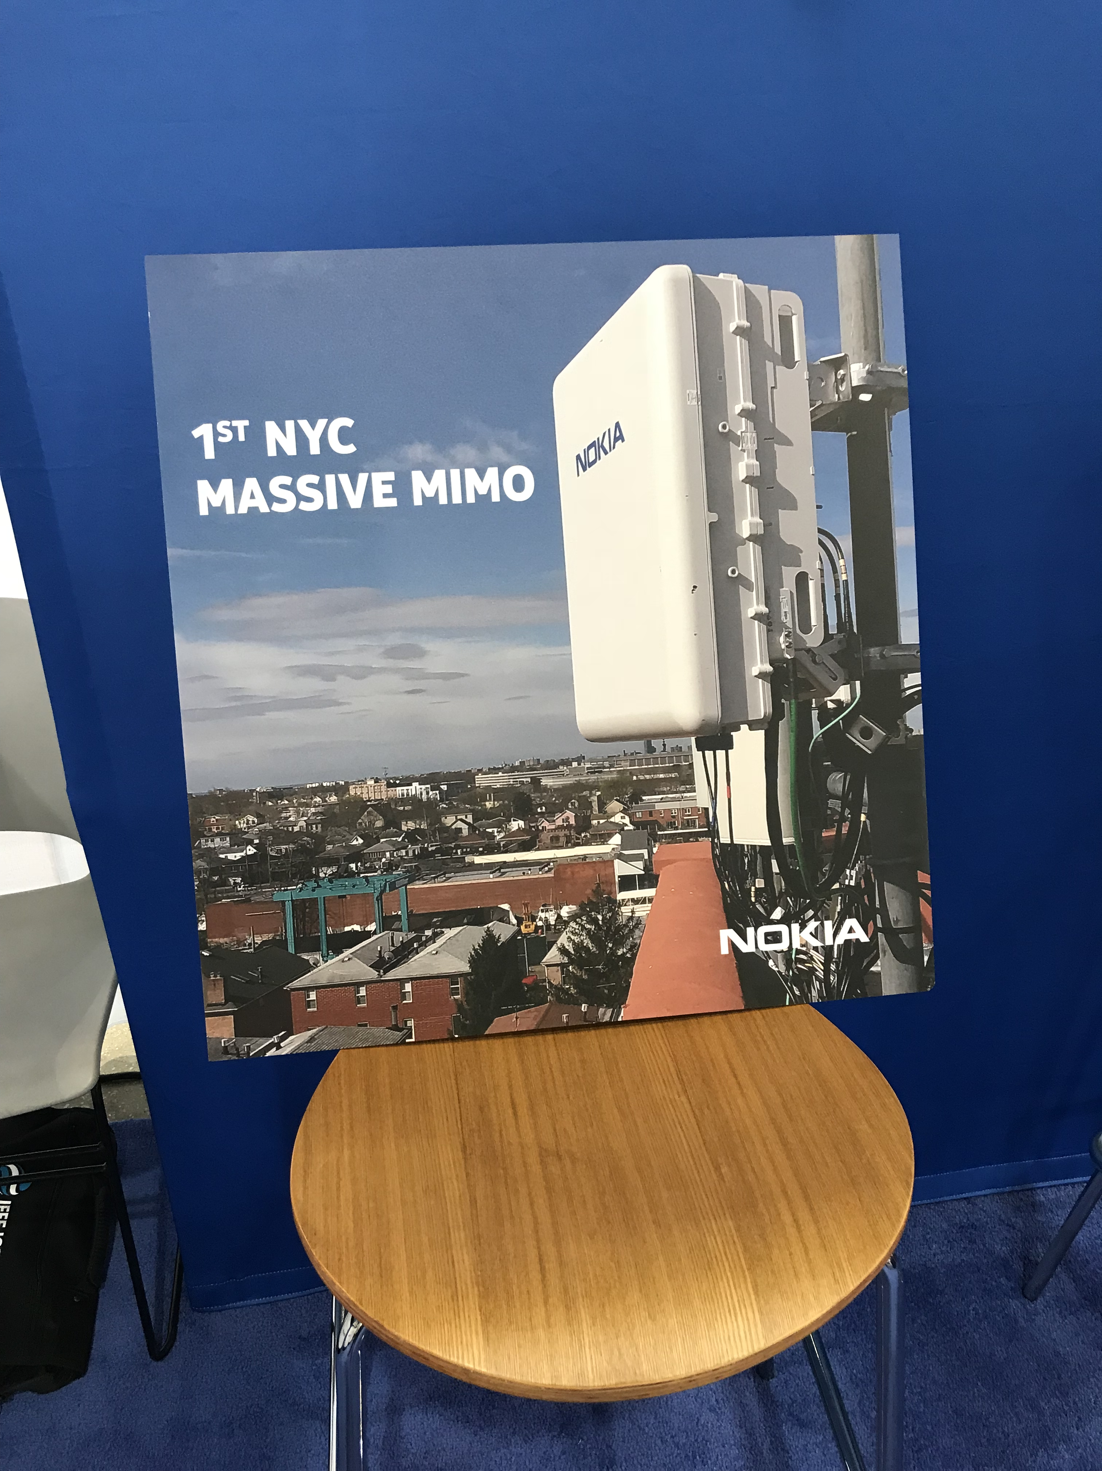
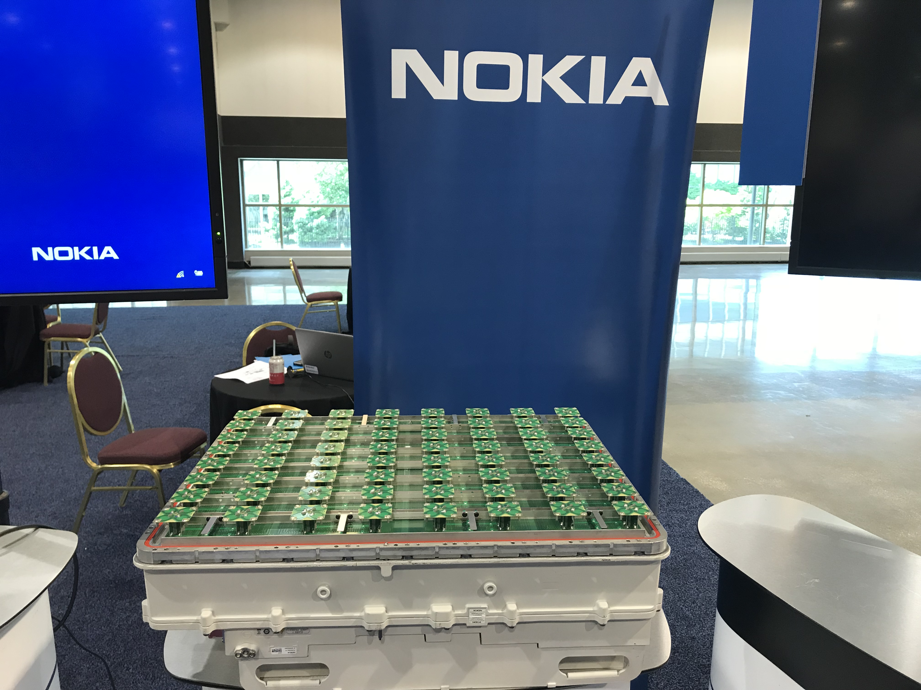
Massive MIMO in 5G
64 antennas
Photo: Erik G. Larsson, May 2018

Slide 13
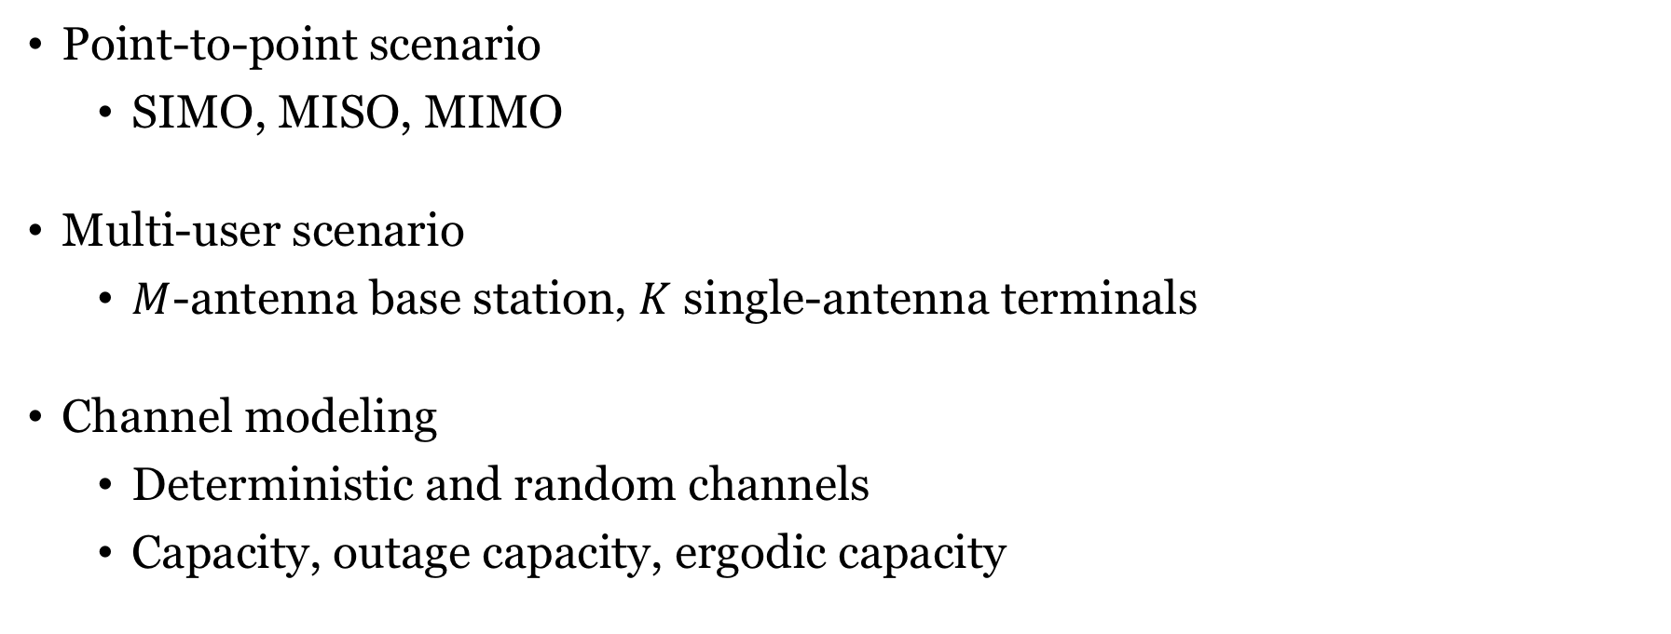
Different aspects: Multiple antenna communications
Point-to-point scenario
SIMO, MISO, MIMO
Multi-user scenario
$M$-antenna base station, $K$ single-antenna terminals
Channel modeling
Deterministic and random channels
Capacity, outage capacity, ergodic capacity

Slide 14
Point-to-point: Better user performance
Beamforming and multiplexing gain

Slide 15
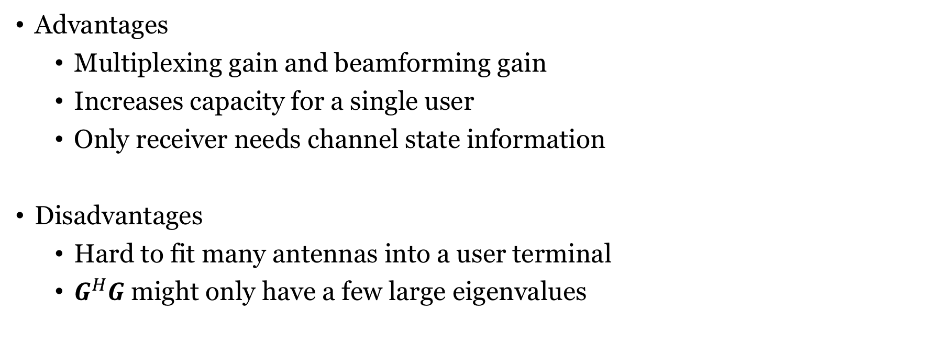
Summary: Point-to-point MIMO
Advantages
Multiplexing gain and beamforming gain
Increases capacity for a single user
Only receiver needs channel state information
Disadvantages
Hard to fit many antennas into a user terminal
$G^{H}G$might only have a few large eigenvalues

Slide 16
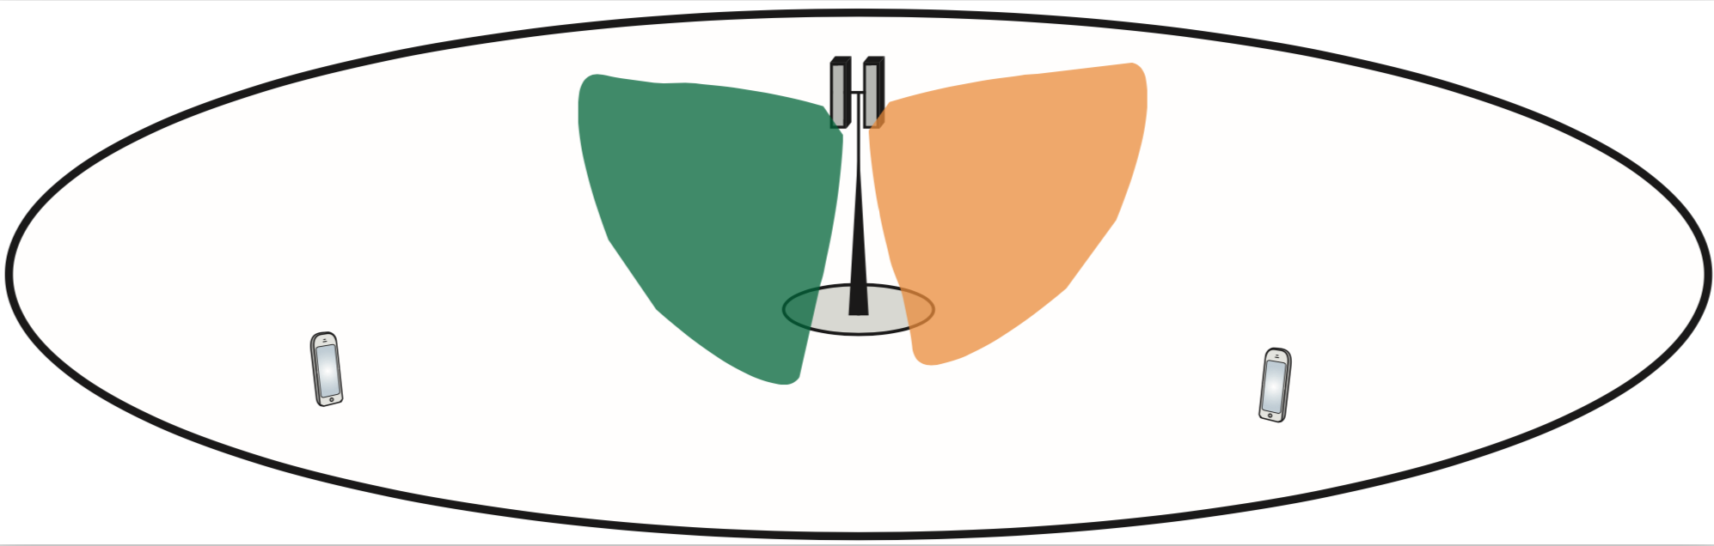
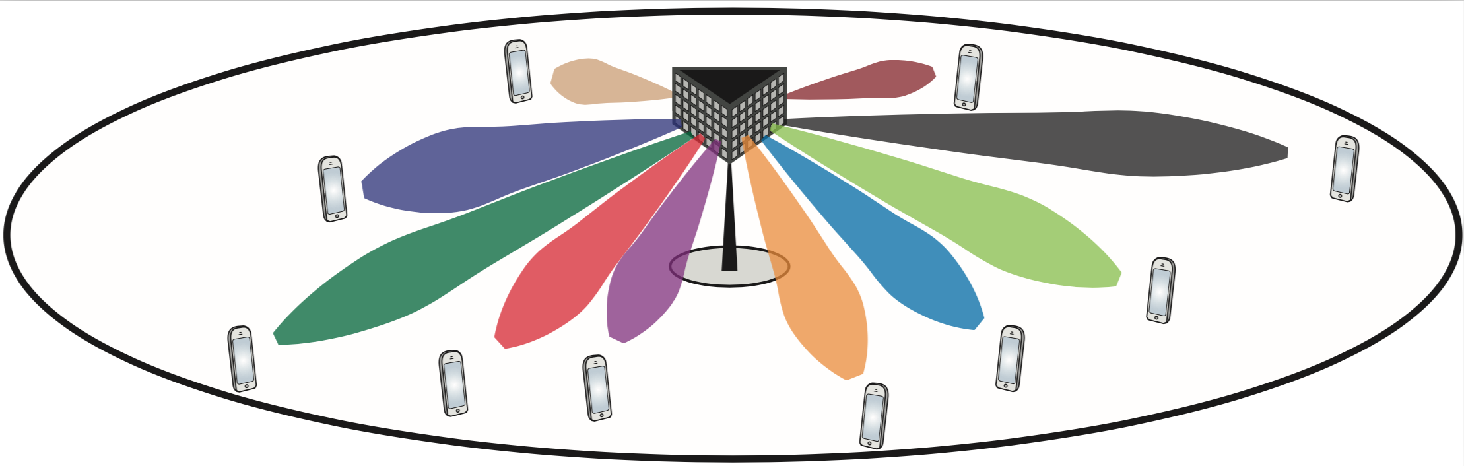
Multi-user MIMO: Spatial multiplexing of users
Few antennas (elements): Broad beams
Serve many users at same time/frequency resource
Narrow beams limit interference
Massive number of antennas: Narrow beams

Slide 17
Summary: Multi-user MIMO
Advantages
Multiplexing gain and beamforming gain: Increases sum capacity
Very scalable technology, any number of antennas, tens of users
Only base station needs channel state information
Disadvantages
Capacity per user does not grow as fast
Require many active users to achieve gains
Must be implemented in the right way (TDD, etc.)

Slide 18
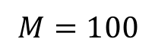
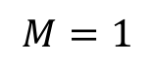
Summary: Fading channels
Diversity gains:
Slow fading
Outage probability
Outage capacity
Fast fading
Ergodic capacity
Coherence intervals
$$M=100$$
$$M=1$$

Slide 19
What have we not covered in the course?
Point-to-point MIMO
Cases with imperfect channel knowledge
Massive MIMO
More advanced processing (zero-forcing, MMSE)
More realistic channels (correlated Rayleigh fading)
Fading channels
Gradual variations, channel tracking and prediction

Slide 20
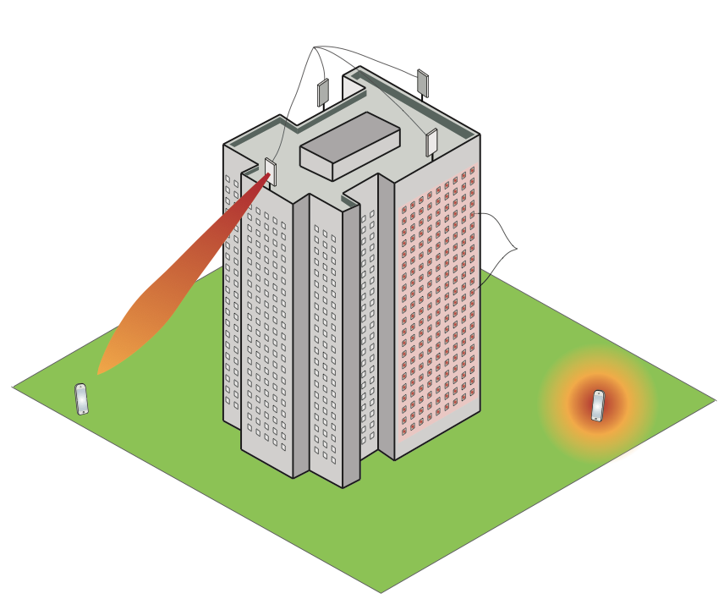
What will happen in the future?
64-antenna
Massive MIMO
New deployment concepts
3) Extremely large aperture arrays
1) Distributed Massive MIMO
(Cell-free)
2) Intelligent reflecting surface

Slide 21
End of Lecture 12
TSKS14 Multiple Antenna Communications

